Slide 1
INFOSYS SPRINGBOARD VIRTUAL INTERNSHIP 6.0
TEAM D
BUDGETWISE AI BASED EXPENSE FORECASTING TOOL
MENTOR: SANGEETHA MAHALINGAM
BY
RISHIKA A

Slide 2
ABSTRACT
BUDGETWISE AI BASED EXPENSE FORECASTING TOOL is an intelligent personal finance management system that enables users to track expenses, plan budgets, and make informed financial decisions. The system integrates a modern web interface with a machine learning-driven backend to provide real-time insights into spending behaviour. Users can record expenses, view visual summaries, and generate monthly budgets through an interactive dashboard. The application employs statistical models and Random Forest algorithms to predict future expenditures and detect anomalous transactions based on historical data. Additionally, an AI-enabled chatbot offers personalized suggestions to improve financial discipline. Data is securely stored using Firebase Authentication and Firestore, ensuring reliable access and privacy. By combining expense management, predictive analytics, and interactive visualization, it enhances user awareness, supports better financial planning, and promotes healthier budgeting habits.

Slide 3
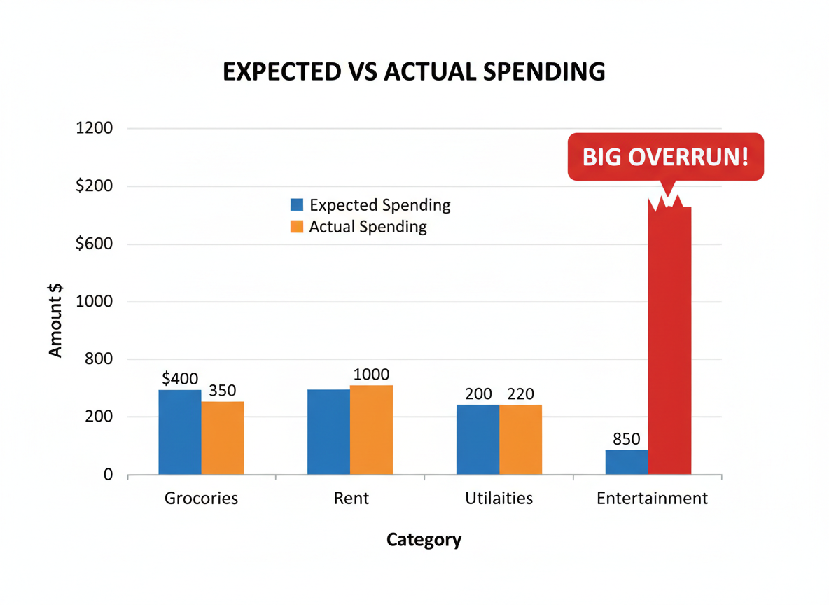
PROBLEM — WHY PEOPLE NEED BUDGETWISE
Expense tracking is manual and time-consuming.
Lack of clear visualization — users can’t spot trends.
Hard to forecast future spending or plan budgets.
Unnoticed anomalies (sudden spikes) lead to surprise shortfalls.

Slide 4

OBJECTIVES
To develop an intelligent system that tracks and analyzes user expenses automatically.
To apply machine learning algorithms for accurate prediction of future spending trends.
To provide visual insights through interactive charts and graphs for better financial understanding.
To assist users in creating personalized budgets based on their income and spending behavior.
To promote financial awareness and help users make informed and data-driven budgeting decisions.

Slide 5
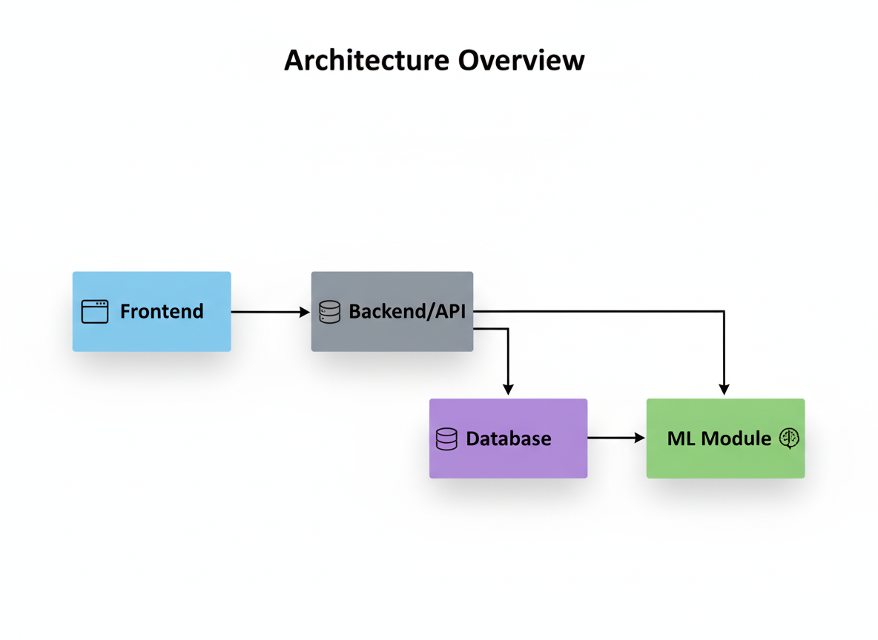
TECH STACK
Frontend: React + Vite, Tailwind CSS, Framer Motion, Chart.js (for data visualization), Firebase SDK for auth / backend.
Backend: Python + FastAPI for API server, Firebase Admin SDK for Firestore / Authentication integration.
Data & ML: Uses scikit-learn for building ML models (Random Forest) for expense prediction & anomaly detection; uses Pandas & NumPy for data processing
Server: Run via Uvicorn ASGI server.

Slide 6

MODULES
User Login:
Allows users to securely register and log in to access personalized expense data and forecasts.
Expense Entry:
Enables users to input and categorize daily expenses, forming the basis for analysis and forecasting.
Expense Analysis:
Analyzes spending habits through visual reports, helping users identify major expense areas and trends.

Slide 7
AI Forecasting:
Utilizes machine learning algorithms to predict future expenses based on historical data patterns.
Budget Recommendations:
Provides smart, personalized budgeting suggestions to help users control overspending and save efficiently.
Report Generation:
Generates detailed monthly or yearly reports summarizing spending, forecasts, and budget insights.

Slide 8
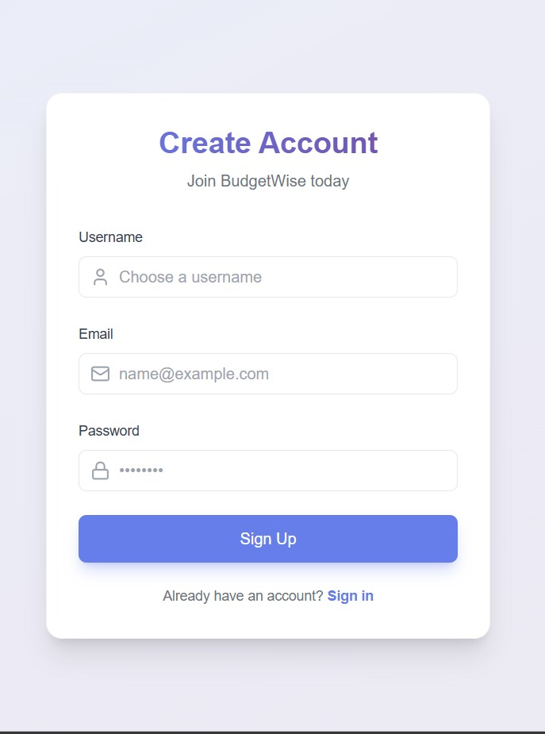
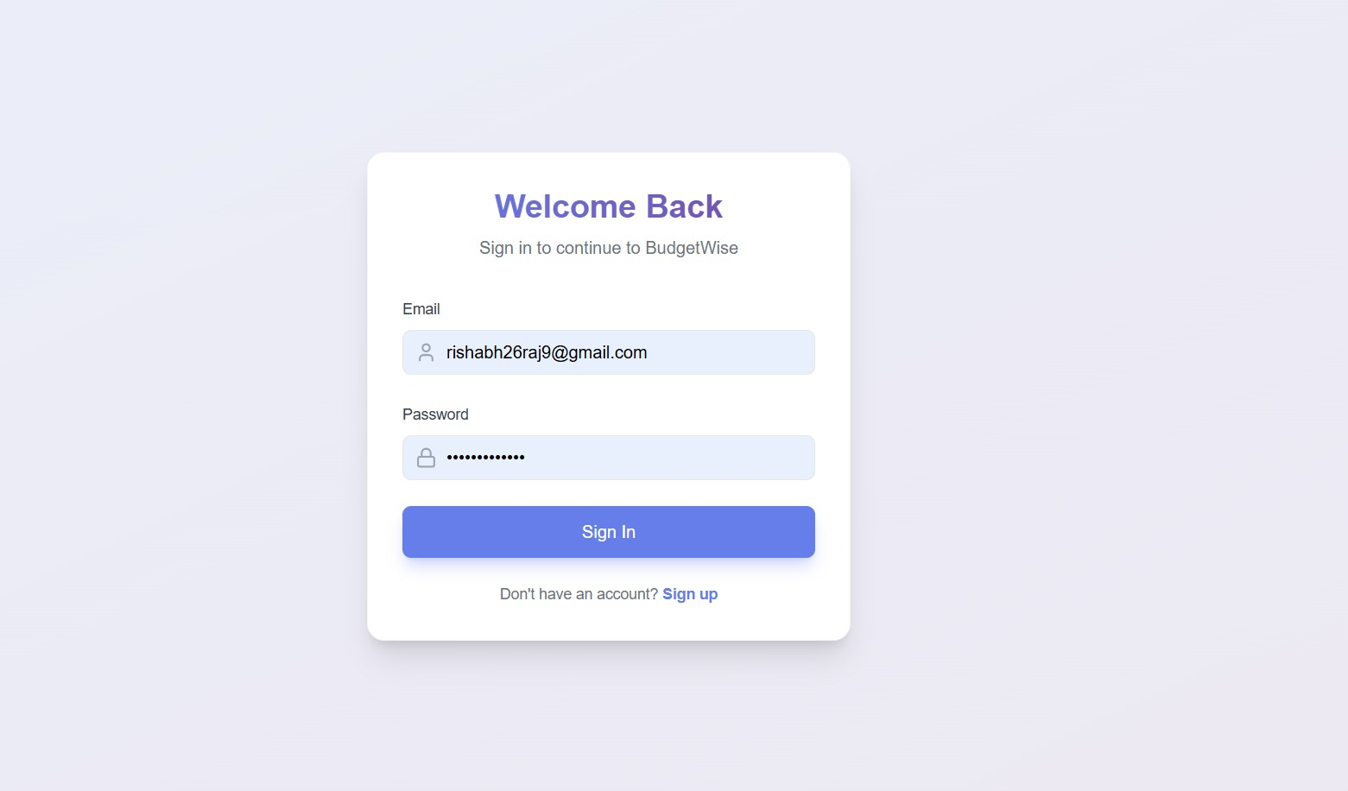
KEY FEATURES OF BUDGETWISE
LOGIN PAGE

Slide 9

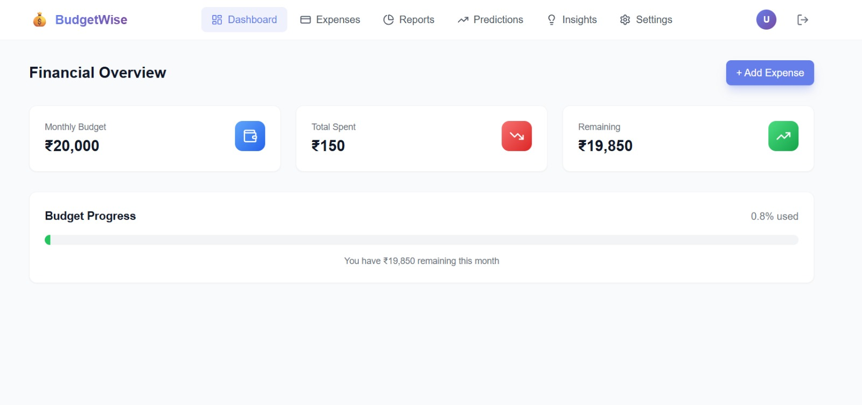
Dashboard Overview

Slide 10

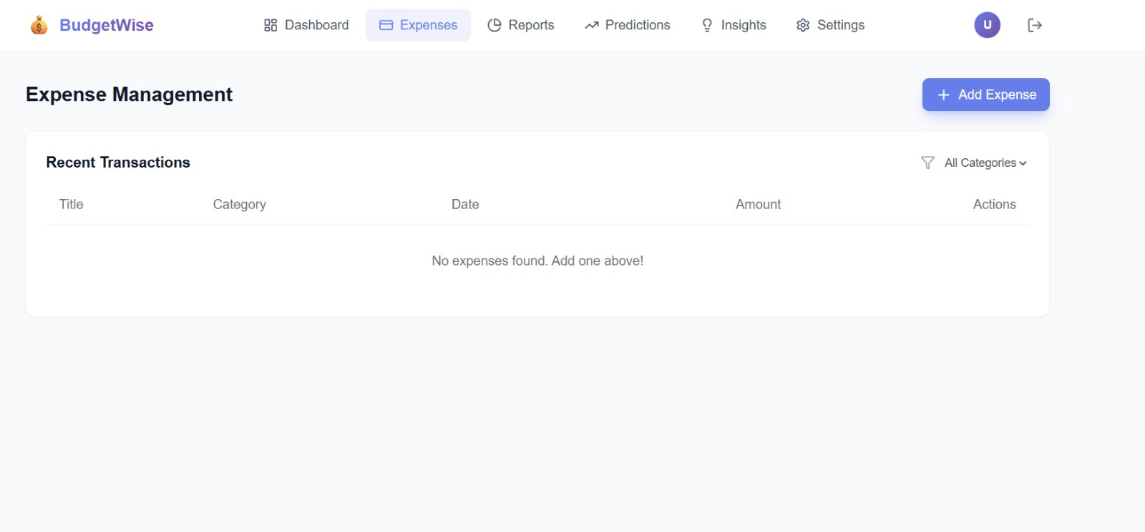
Expense Tracking

Slide 11

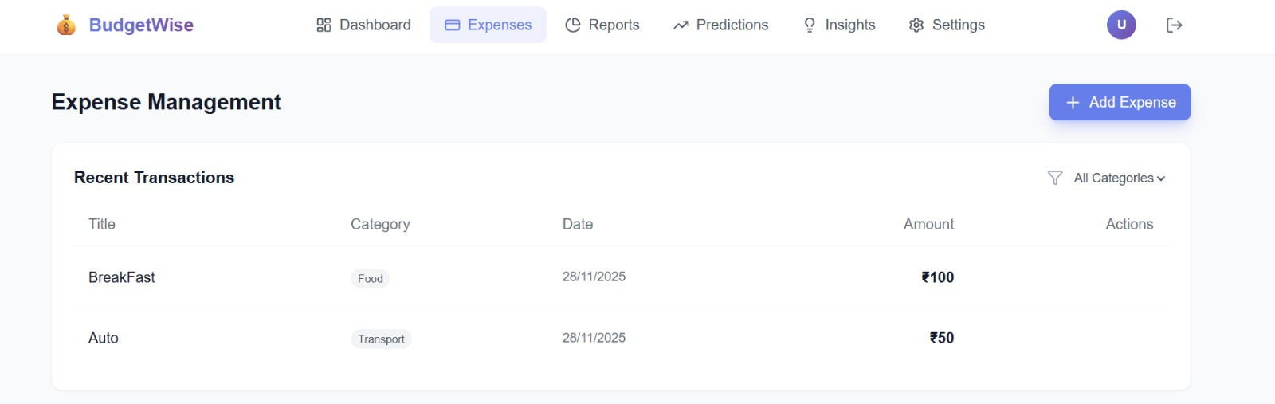
Smart Budgeting

Slide 12

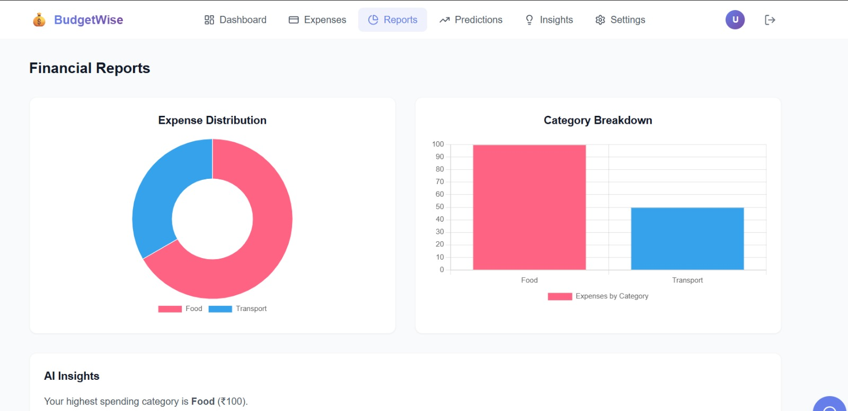
Visual Analytics

Slide 13
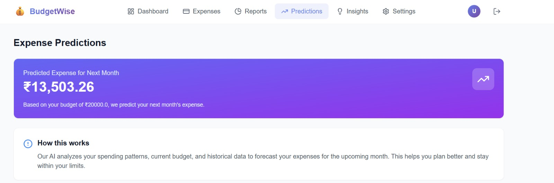
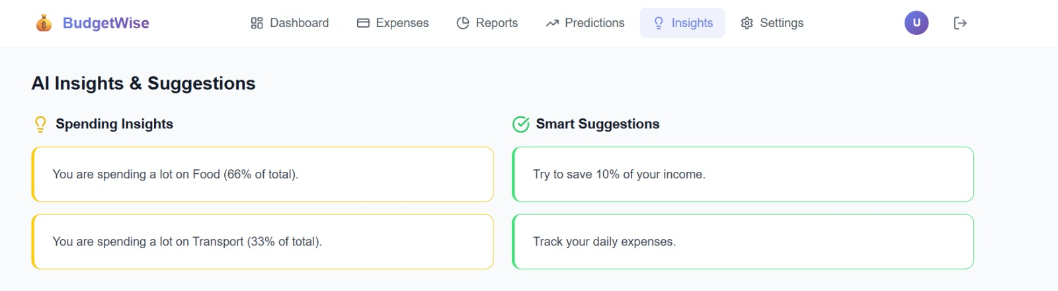
AI-Based Predictions

Slide 14
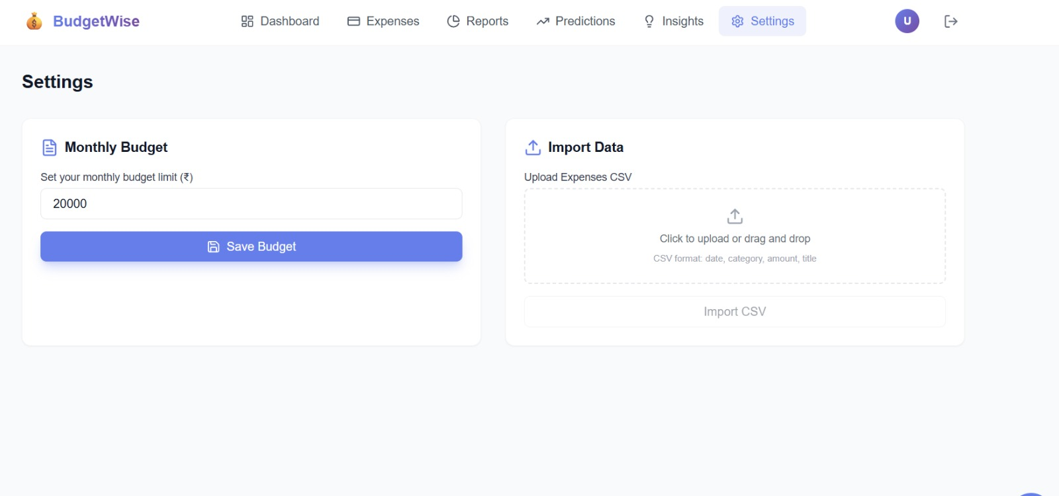
CUSTOMIZE YOUR BUDGET & DATA

Slide 15
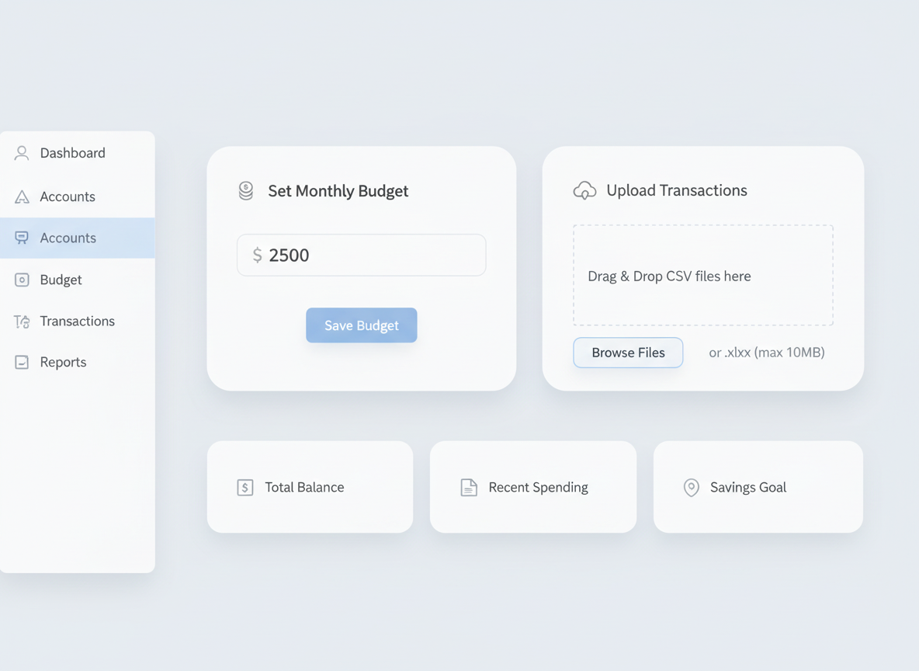
DATA FLOW
1.Enter your monthly budget limit in the input field provided.
2.Click the “Save Budget” button to store your monthly budget settings.
3.Upload your expense data by dragging and dropping a CSV file into the upload area.
4.Ensure the CSV follows the required format: date, category, amount, and title.
5.Click the “Import CSV” button to process and store the uploaded expense data.

Slide 16

Voice-enabled virtual assistant for financial queries
FUTURE ENHANCEMENTS
Automatic bill tracking and reminders
Integration with bank accounts and payment apps
Advanced data visualization and custom dashboards
Mobile app version with offline support
Voice-enabled virtual assistant for financial queries

Slide 17
CONCLUSION
BUDGETWISE AI BASED EXPENSE FORECASTING TOOL provides an intelligent and user-friendly platform for managing personal finances by combining expense tracking, budgeting, predictive analytics, and data visualization. The system empowers users to gain better awareness of their spending habits, plan budgets effectively, and make informed financial decisions. With features such as AI-based predictions, anomaly detection, secure data handling, and CSV integration, BudgetWise goes beyond traditional finance tracking tools by offering actionable insights and automation. Although there are opportunities for future enhancements, the project demonstrates a strong foundation in full-stack development, machine learning, and UI design, showcasing its potential to evolve into a comprehensive financial management solution.

Slide 18
THANK YOU!!

